Slide 1
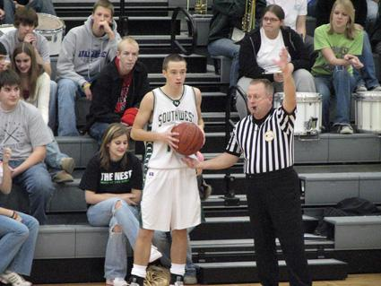
RULE 7
Out of Bounds & The Throw-In

Slide 2
RULE 7: OUT OF BOUNDS & THROW-IN
A Player is out of bounds when he/she touches the floor or any object other than another player or person on or outside the boundary line.
Inadvertently touching someone who is out of bounds is not a violation. Casebook 7.1.1 Situation A.
The Ball is out of bounds when it touches:
A player who is out of bounds
Any other person, the floor, or any object that is on or outside the boundary
Supports or back of the backboard
Ceiling or overhead equipment or supports
Ball is out of bounds if it completely passes over a rectangular backboard

Slide 3
RULE 7
Who causes the ball to go out of bounds?
The last person to touch the ball inbounds before it goes out of bounds
The first person a loose ball touches that is out of bounds (prior to the ball being considered out of bounds)
The person who is out of bounds if a controlled ball is touched while a player is out of bounds
A thrower must have a minimum of three (3) feet allowed to throw in.

Slide 4
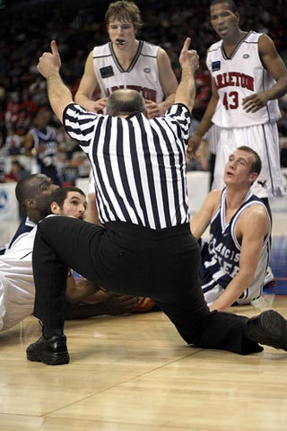
RULE 7
If a ball goes out of bounds and:
The officials do not know who touched it last, it is to be considered to be out of bounds simultaneously
Results in an AP throw in at nearest one of the four throw-in spots if in the team’s frontcourt or the spot nearest the violation when in the team’s backcourt.
If this takes place prior to the AP procedure being established, a jump ball will occur in the center circle between the two players who caused the ball to go out of bounds

Slide 5
RULE 7
The ball is awarded out of bounds to a team following:
A. A violation—nearest one of four designated throw-in spots in the frontcourt or nearest the spot in the backcourt of the violation regarding which team receives possession. (Spot Throw In, most of the time.)
B. A free throw after a technical foul—division line, in the backcourt, opposite the table. (Spot Throw In)
C. A free throw after a flagrant or intentional foul—at the spot of the foul in the backcourt or nearest one of four designated spots in the frontcourt depending which team receives possession. (Spot Throw In)
D. After a made free throw or field goal. End line—can run the end line. A kicking violation near the endline in this situation does not lose the right to run the end line for the throw-in.
E. A player control or team control foul—at spot of the foul in backcourt or nearest spot of the four designated spots in the frontcourt . (Spot Throw In)
F. After a common foul before the bonus is in effect—at spot of foul in the backcourt or one of the four designated frontcourt spots nearest the foul. (Spot Throw In Unless Case Book Play 7.5.7 Situation C.a)

Slide 6
RULE 7
Resuming Play Procedure
For a throw in, this only occurs after a time out or after an intermission between quarters.
If team A is not ready, place the ball on the floor and begin the five-second count.
If throw in team violates, sound the whistle and award throw-in to B.
If team B is not ready, place the ball on the floor and begin the five-second count.
Any additional delays result in technical foul (team technical).

Slide 7
RULE 7
Designate a throw-in spot for:
a throw in after any violation
EXCEPT: defensive basket interference, goaltending, or a violation by the defense after a made basket, made free throw, awarded basket or Free Throw (if the violation would result in the ball being put in play along the end line).
These violations result in the run of the end line for throw-ins
Use appropriate signal to dictate which type of throw-in it is, ESPECIALLY when on/along end line.

Slide 8
RULE 7
NEVER have a spot throw in from behind/underneath a backboard. Move it to either lane-line extended
After a double foul, double technical foul, or a simultaneous foul, play is resumed at the point of interruption and the team with the ball retains possession with a designated spot throw in nearest to one of the four designated spots in the frontcourt or where the ball was in the backcourt when the fouls occurred

Slide 9
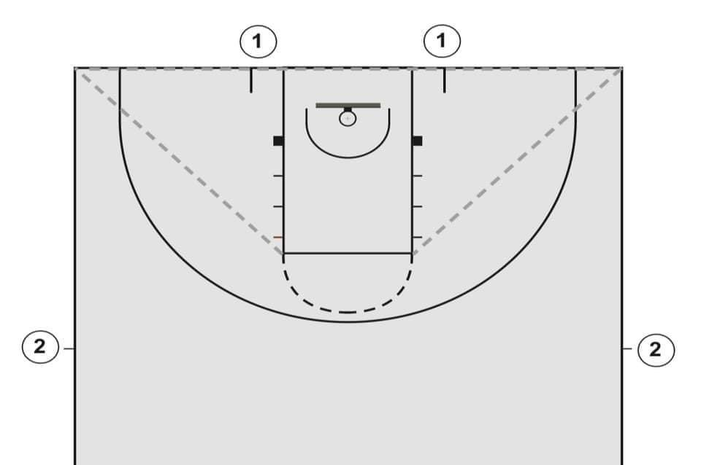
RULE 7
After a free throw violation by the throwing team when no additional free throws are to follow, the offended team is entitled to a throw in from a spot out of bounds, nearest the violation in their backcourt.

Slide 10
RULE 7
Throw In Begins:
A. When at the disposal of a player
B. Count begins when ball is at disposal of a player
C. Throw in count ends when the ball is released onto the court
D. The thrown ball is to be released so that it goes directly onto the playing court (or out of bounds: Exception 7-5-7)
E. The thrown ball is to touch another player who is in bounds or out-of-bounds.

Slide 11
RULE 7
F. An offensive teammate cannot touch the thrown ball on the out of bounds side of the court
G. On a designated spot throw in, the thrower shall not leave the spot prior to releasing the ball
H. Defensive players cannot have any part of their bodies on the out of bounds side of the court until the ball is released
I. The throw in ends when the ball is legally touched or touches an in-bounds or out-of-bounds player, or when the throw-in team commits a violation
J. Any backcourt count does not begin until Team A player has CONTROL of the ball

