Slide 1
BASKETBALL
Rule 4 Definitions: Definitions of Playing Terms
Notes:
1

Slide 2
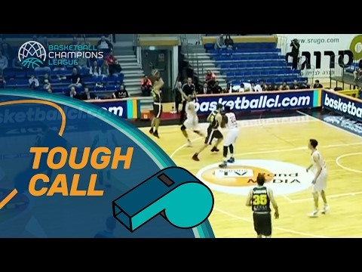
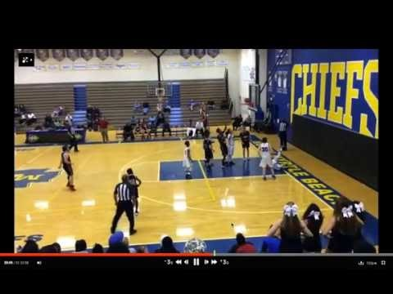
Rule 4 Definitions
This Rule/Section combined with Rules 9 (Violations) and 10 (Fouls) are the most important to master
Airborne Shooter—A player who is in the act of shooting, has released the ball on a try for goal and has not returned to the floor. If he is fouled, he is fouled in the act of shooting and if he fouls, he has committed a player control foul (unless he commits a technical foul.)
When a player becomes an airborne shooter, he/she must be able to return to the floor without a defender in that space.
When does an airborne shooter return to the floor?
Notes:
2

Slide 3
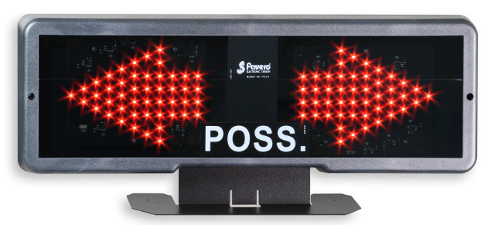
Rule 4 Definitions
Sec 2 & 3 Alternating Possession– a method of putting the ball in play via throw-in. Initial direction of throw-in is established in the following manner:
A. The initial direction of the arrow is set when a player gains control of the jump ball. B. The ball is at the disposal of the free thrower after a common foul when the bonus rule is in effect. (This can only happen in overtime.) C. The ball is placed at the disposal of the thrower after: 1. A violation during or after the jump and before a player secures possession.
2. A free throw for a non-common foul.
3. A common foul before the bonus rule is in effect.
Notes:
3

Slide 4
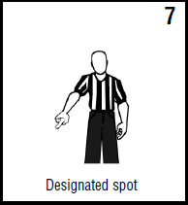
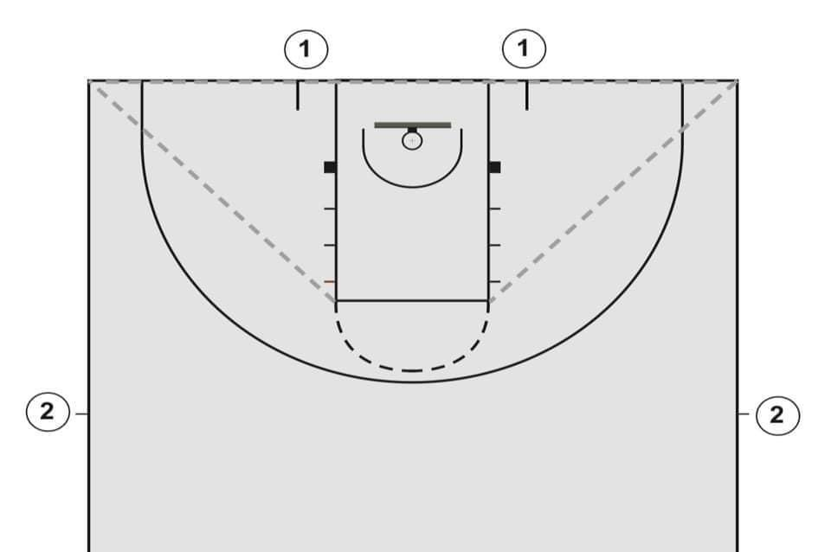
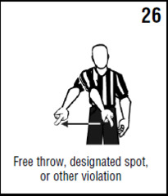
Rule 4 Definitions
Sec 4 Ball Location
A. The ball which is in contact with a player or with the court is in the backcourt if either the ball or the player is touching the backcourt. The ball continues to be in the backcourt until the player and the ball have gained frontcourt status. (see B, C, D for ball location status)
Notes:
4

Slide 5
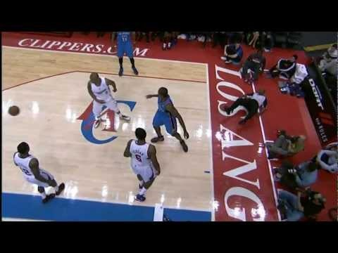
Rule 4 Definitions
B. A ball in flight has same location as when it was last in contact with the floor or player.
C. A ball which touches a player or an official is the same as the ball touching the floor at that person’s location.
D. A ball that touches the backboard is the same as touching the floor, except a ball that touches the thrower’s backboard does not constitute a dribble.
Notes:
5

Slide 6
Rule 4 Definitions
E. During a Dribble from backcourt to frontcourt, the ball is in the frontcourt when the ball and both feet of the dribbler, touch entirely the court, in the front court.
F. Ball is at disposal of a player when it is: 1. Handed to a thrower or free-thrower 2. Caught by a thrower or free-thrower after
bounced to them 3. Placed on the floor at the spot 4. Is available after a goal (end line throw)
Notes:
6

Slide 7
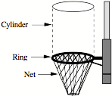
Rule 4 Definitions
Basket—A team’s own basket is the one that they try to throw or tap the ball into
First half, team shoots at basket that is farther away from the team bench
Second half and Overtime, team shoots at basket nearest team bench
Notes:
7

Slide 8
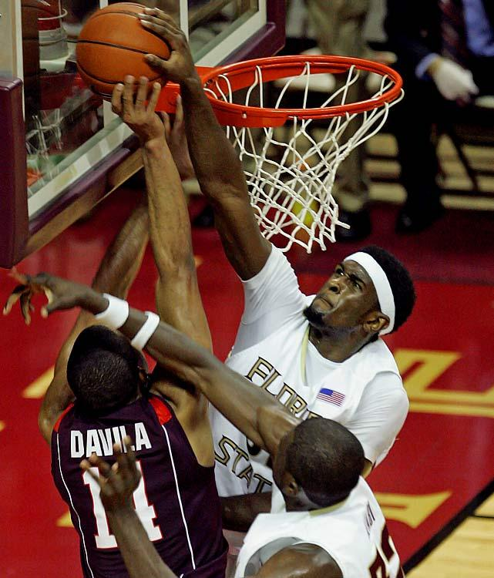
Rule 4 Definitions
Basket Interference is a violation that occurs when a player :
A. touches the ball or any part of the basket while the ball is on or within either basket
B. touches the ball while any part of it is within the imaginary cylinder which has the basket ring as its lower base
C. Touches the ball outside of the cylinder while reaching through the basket from below
D. Pulls down movable ring so that it contacts the ball before returning to its original position
(Whether you think the try has a chance to go in is not part of BI)
Notes:
8

Slide 9
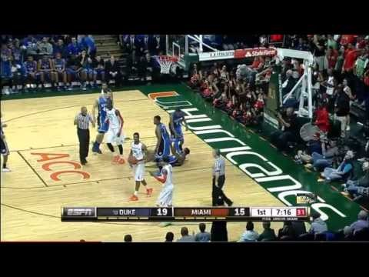
Rule 4 Definitions
Blocking—A Foul that is illegal personal contact that impedes the progress of an opponent
Illegal screen
Charging—A Foul that is illegal personal contact caused by pushing or moving into an opponent’s torso
Player Control
Blarge=Bad
You make the call
Block-Charge?
Player Control or Block?
Incidental contact or Block/Charge?
Notes:
9

Slide 10
Rule 4 Definitions
Bonus Free Throw—the bonus is the two free throws awarded for a common for a common foul (except for a player-control to team control foul) as follows:
Beginning with a team’s fifth foul of each quarter, two free throws are awarded, regardless of whether or not the first free throw is successful.
Team fouls will be reset to zero at the end of each quarter.
Notes:
10

Slide 11
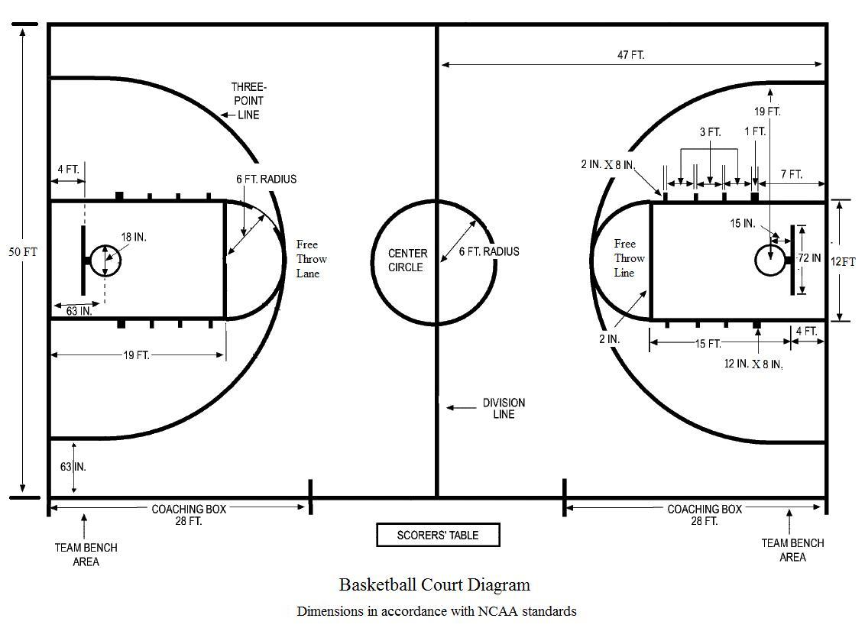
Rule 4 Definitions
Boundary Lines—consists of end lines and sidelines
Inside edges
of lines separates the in-bounds and out-of-bounds areas
Notes:
11

Slide 12
Rule 4 Definitions
Parts of the Court
Front Court: The part of the court between the end line and the nearest edge of the division line on the side of the court is shooting at. (Everything in front of the Division Line!)
Back Court: The part of the court between the end line and the entire division line on the side of the court a team is defending. Bigger by 2 inches!
Notes:
12

Slide 13
Rule 4 Definitions
Closely Guarded—only happens in the front court. Count is five seconds—Defensive player (s) must be within 6 feet (toe-to-toe) of the offensive player who is holding or dribbling the ball.
Offensive player (player A) can hold for 4.9 seconds, dribble for 4.9 seconds, hold for 4.9 seconds before violation is committed!
Is this closely guarded? CloselyGuardedorNot
Or is this closely guarded? CloselyGuarded?
Notes:
13

Slide 14
Rule 4 Definitions
Continuous Motion: Applies only to the offense and is only relevant if a defensive player (player B) fouls an offensive player (player A)
If player A fouls after he or a teammate has started the habitual motion but before the ball is in flight, the ball becomes dead immediately and no goal can score
Half court shot
Layup
Great mechanic layup
If the foul is by B (not necessarily the shooter), continuous motion applies if player A has begun the habitual motion that normally precedes a shot.
If A player dribbles after the foul, no continuous motion applies.
Notes:
14

Slide 15
Rule 4 Definitions—Control
Player Control: A player is in control when he is holding or dribbling a live ball. There is no player control during a throw in or during an interrupted dribble.
Team Control: There is team control:
when a player is holding or dribbling a live ball.
when the ball is being passed among teammates
during an interrupted dribble
during a throw-in only relates to fouls
No Team Control exists:
during a try/tap for goal until a ball is rebounded
during a jump ball
while the ball is dead
Notes:
15

Slide 16
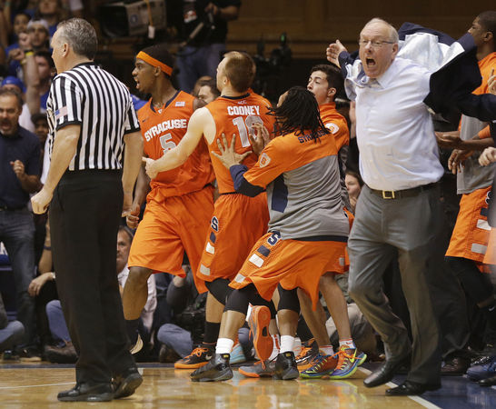
Rule 4 Definitions
Disqualified Player: A player barred from further participation in the game. A player has been disqualified when the head coach is notified by an official.
Notify coach, notify timer (starts 15 second count), player, fellow officials when player has 5 fouls (combo), 2 Technical Fouls, or 1 Flagrant.
Notes:
16

Slide 17
Rule 4 Definitions
Dribble: Controlled activity by a player who intentionally strikes the ball with his hand(s), pushing the ball to the floor once or multiple times.
must start a dribble before lifting his pivot foot
dribble ends when player catches it or causes it to come to rest in one or both hands, it simultaneously touches the ball with both hands, the opponent touches the ball and causes the dribbler to lose control or the ball becomes dead.
it is impossible to travel while dribbling!
Is this an illegal dribble?
Notes:
17

Slide 18
Rule 4 Definitions
Interrupted Dribble: When a dribbler loses control of the ball after deflecting off the dribbler or accidentally/momentarily gets away from dribbler. There is no player control during an interrupted dribble. Therefore:
No time out can be called or granted
A closely guarded count cannot start (or should end)
There can be no player control foul (can be TC foul?)
Out of bounds violation does not apply on the player involved in the interrupted dribble.
3 seconds violation is still possible
Notes:
18

Slide 19
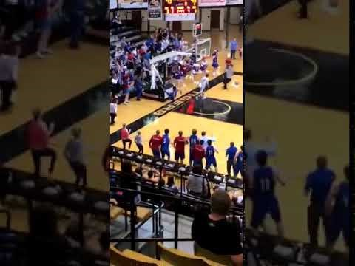
Rule 4 Definitions
Fighting: Is a flagrant act (Flagrant foul/Technical foul) where fighters are to be DISQUALIFIED! Can occur during a live ball (flagrant personal foul) or a dead ball (flagrant technical foul.) Contact is not required for a player to be guilty of fighting. Includes an ATTEMPT to
Strike
Punch
Kick
Using a fist, hands, arms, legs, or feet!
What about words that cause retaliation?
Notes:
19

Slide 20
Rule 4 Definitions: Fouls
An infraction of the rules that is charged and penalized
Personal Foul: A live ball foul that involves Illegal Contact with an opponent. Contact causes an advantage to be gained over an opponent
Player also commits a personal foul when a dead ball foul is committed against an airborne shooter
Common Foul: A personal foul that is neither Flagrant (ejection) nor Intentional and is not committed against a player trying or tapping for goal. It is not part of double, multiple, or simultaneous fouls
Only shoot FTs when fouled team is in bonus (5th team foul each qtr =2)
All Common fouls are Personal fouls, but not all Personal fouls are Common fouls.
Notes:
20

Slide 21
Rule 4 Definitions: Fouls
Intentional Foul: A personal or technical foul which neutralizes an opponent’s obvious advantage, contact away from the ball with an opponent who is clearly not in the play, or when not making a legitimate play on the ball.
Designed to make the clock stop or keep from starting!
Making excessive contact.
Excessive contact above the shoulders by a moving elbow—in the head! (Points of Emphasis 2012-13 rules book page 67-68. And Rules Book 2021-22 Case Book plays 9.13.1 Situation B and 9.13.2)
Contact with a thrower-in during an in-bounds play
Notes:
21

Slide 22
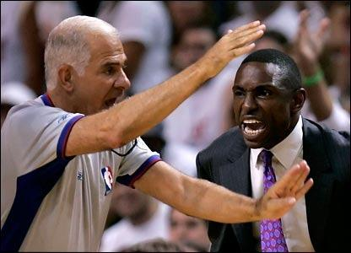
Rule 4 Definitions: Fouls
Flagrant Foul: Personal or Technical foul of a violent or savage nature or a non-contact technical foul that displays unacceptable conduct.
May include excessive moving elbow contact above the shoulders. (2012-13 Rules Book Points of Emphasis)
(2021-22 Rules Book Case Book plays 9.13.1 situation B, 9.13.2)
The offender is automatically disqualified.
Notes:
22

Slide 23
Rule 4 Definitions: Fouls
Technical Foul—a foul by a non-player, a non-contact foul by a player, intentional or flagrant contact foul while the ball is dead.
A Direct Technical Foul is assessed to the head coach for allowing a disqualified player to re-enter
Player Control Foul—Committed by a player while in control of the ball or as an airborne shooter
Team Control Foul: A common foul committed by a member of a team that has team control, including while out of bounds on throw in.
Notes:
23

Slide 24
Rule 4 Definitions: Fouls
Double Fouls: Occur when two opponents commit personal fouls against each other at approximately the same time. No shots occur. Resume play at Point of Interruption
Example: 4.19.8.C Case Play
BlockChargeorBlarge
Double Technical Fouls: Occur when two opponents commit technical fouls against each other at approximately the same time. No shots occur. Resume play at Point of Interruption.
Notes:
24

Slide 25
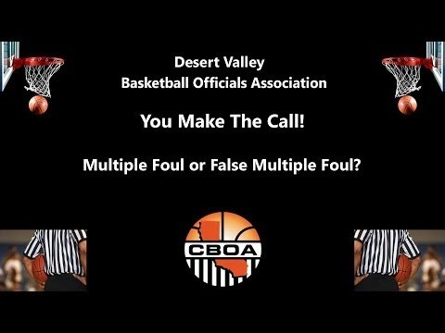
Rule 4 Definitions: Fouls
False Double Fouls: Occur when there is a foul by both teams, the second foul takes place after the first and before the clock has next started. Each foul carries its own penalty.
Simultaneous Fouls: Can be personal or technical. Fouls by both teams at approximately the same time. (Example: A1 against B1 and B2 against A2. No Shots. Resume a point of interruption
Notes:
25

Slide 26
Rule 4 Definitions: Fouls
False Multiple Fouls: When two or more fouls are committed by the same team and the last foul is committed before the clock has started. We could have FTs!
Team Foul: Any Personal or Technical foul which is charged to a team. All team fouls count toward reaching the bonus
Unsporting Foul: A non-contact technical foul which consists of unfair, unethical, or dishonorable conduct
Notes:
26

Slide 27
Rule 4 Definitions
Free Throw: An unhindered try for goal that counts as one point if successful. It must be taken within the free throw semi-circle behind the free throw line.
Starts when the ball is at the disposal of the free thrower/caught by the free thrower.
Ends when:
the try is successful,
when the try touches the floor, any player, or
the ball becomes dead or this way
Notes:
27

Slide 28
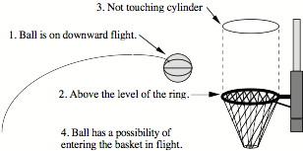
Rule 4 Definitions
Fumble: Accidental loss of player control
Goaltending: A violation when player touches the ball during a try and all 4 components exist.
Score 1 (FT), 2 or 3 points.
May also occur during a FT. Score 1 pt & technical foul
Notes:
28

Slide 29
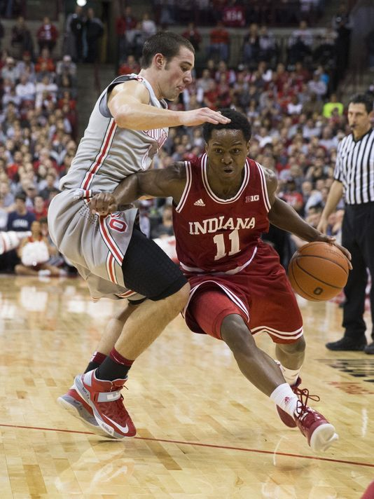
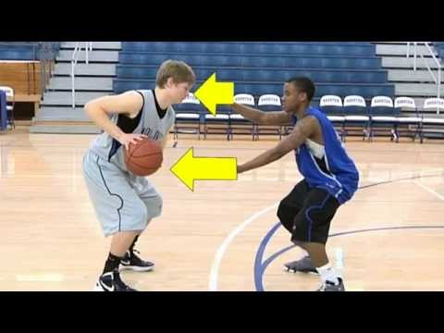
Rule 4 Definitions
Guarding: A defensive technique that is a legal act of placing the body in the path of an offensive opponent. To obtain legal guarding position:
Both feet must be on the floor inbounds
Defender’s torso must be facing the opponent
Foul or No call?
Notes:
29

Slide 30
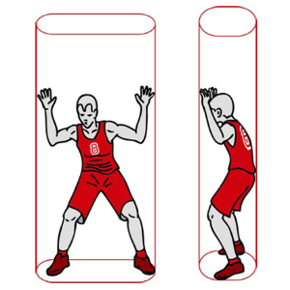
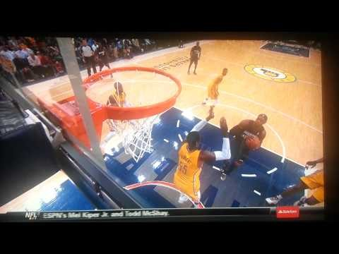
Rule 4 Definitions
Guarding (cont.)
Defender can maintain legal guarding position (LGP) by moving laterally or obliquely to maintain position.
The guard may jump or raise hands vertically within his own vertical plane
Guard may duck or turn to absorb the shock of imminent contact.
Notes:
30

Slide 31
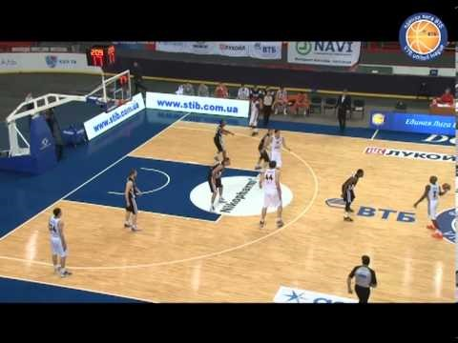
Rule 4 Definitions
Guarding an opponent With the Ball or a stationary opponent Without the Ball
No time or distance is required to obtain initial LGP
If the opponent with the ball is airborne, the guard must have obtained legal position before the opponent left the floor.
Guarding a Moving Opponent without the ball
Time and distance are factors
Guard must give opponent time and distance to avoid contact
Distance need not be more than two strides
If the opponent is airborne, the guard must have obtained LGP before the opponent left the floor
Legal and Illegal Screening
Notes:
31

Slide 32
Rule 4 Definitions
Legal and Illegal Use of Hands and Arms
Legal to extend the arms above the shoulders, need not be lowered to avoid contact
Legal to block or slap the ball and accidentally hitting the hand of the opponent when it is in contact with the ball
Legal to hold the hands/arms in front of face or body to absorb contact by an imminent charge by an opponent
Freedom of Movement
Notes:
32

Slide 33
Rule 4 Definitions
Not legal to use hands, arms, hips, or shoulders to force way through a screen or hold a screener and then push away/aside in order to maintain guarding position
Not legal to use body parts to inhibit freedom of movement
Not legal to use hand or forearm to prevent an opponent from attacking the ball during a dribble or try for goal
Not legal to swing arms or elbows excessively
Illegal to lock arms with teammates in an effort to restrict the movement of an opponent
Notes:
33

Slide 34
Rule 4 Definitions
Held Ball: Occurs when opponents have their hands on the ball and control cannot be obtained without undue roughness, or when an opponent places his hands on the ball and prevents an airborne player from releasing the ball on a try or pass.
Holding: Illegal personal contact that interferes with an opponent’s freedom of movement.
Incidental Contact: Contact that is permitted and which is not a foul. Not all contact in a basketball game is a foul, but all fouls require contact.
Jump Ball: One of three ways to get a dead ball live. ONLY starts a game or overtime periods.
Notes:
34

Slide 35
Rule 4 Definitions
Kicking the Ball: It must be an INTENTIONAL ACT done with ANY part of the leg or foot. You mostly see the defensive team kick the ball—the offense rarely violates the kicking rule!
Pass: Ball movement by a player who throws, bats, or rolls the ball to another player
Penalties:
A. Fouls are penalized by charging the offender for the illegal act and awarding of Free Throws or a throw-in
B. Violations are penalized by awarding the ball to the opponents for a throw in, or awarding of one or more points, or awarding of a substitute free throw.
Pivot: Occurs when a player who is holding the ball steps once or more than once in any direction with one foot, while the other foot (pivot foot) remains at its point of contact on the floor
Notes:
35

Slide 36
Rule 4 Definitions
Player Location: Determined by where a player is touching the floor. Used to determine in-bounds/out of bounds, backcourt/frontcourt, outside/inside the three point line.
Is this a backcourt violation?
You are where you were until you get to where you were going
Back court to front court and vice versa
Out of bounds to in bounds and vice versa
Behind the 3 point arc and vice versa
Notes:
36

Slide 37
Rule 4 Definitions
Point of Interruption: Method of resuming play after an inadvertent whistle, interrupted game, a correctable error, a double personal foul, double technical foul, or simultaneous foul.
Play is resumed by:
Throw-in to the team last in control at the nearest spot of control
A free-throw or throw-in when the interruption occurred, assuming the team is entitled to such
An AP throw-in when no team is in control and no goal, infraction, nor end of period is involved
Notes:
37

Slide 38
Rule 4 Definitions
Rebounding: An attempt to secure control of the ball after a try or tap. No team or player control during rebounding action.
Resumption of Play Procedure: Method of Preventing Delay of Game by putting the ball back in play after a time out or after an intermission or when throw-in team does not make a thrower available
Get both teams out of time out
Whistle
Ball on ground and start 5 second count
Give Team B same opportunity
Technical Fouls follow
Notes:
38

Slide 39
Rule 4 Definitions
Screen: Legal action by a player, who, without causing contact, delays or prevents an opponent from reaching a desired position.
Legal Screens:
May face any direction
Time and distance are relevant
Screener must be stationary, except when both are moving in the same path and direction
Screener must stay within his vertical plane with a stance shoulders wide
Notes:
39

Slide 40
Rule 4 Definitions
When Screening a stationary opponent within his visual field (front or side), screener can be anywhere short of contact.
When screening a stationary opponent from behind (outside visual field), must allow one step backward without contact.
When screening a moving opponent, must allow time and distance to avoid contact.
When the screener INITIATES contact, a foul shall be called for an illegal screen (Block Signal for defense, Player Control Signal for Offense)
Notes:
40

Slide 41
Rule 4 Definitions
Act of Shooting: Begins with the start of the try or tap and ends when the ball is clearly in flight and includes the airborne shooter. Only has relevance when the defense fouls.
Try: This is when a player attempts to throw the ball into his own basket.
Important to know when there is a foul by the defense. Player does not actually have to release the ball, as a foul may prevent this.
Starts when a player begins the habitual motion (gather) that precedes the release of the ball..
Try ends when the throw is successful, when it becomes certain the throw is unsuccessful, when the ball touches the floor, or when the ball becomes dead.
Tap: Contacting the ball with any part of the players hand in an attempt to direct the ball into the goal.
Starts when the player touches the ball and ends the same as a try.
Notes:
41

Slide 42
Rule 4 Definitions
Throw-in: A method of getting the ball in play from out of bounds.
Throw-in and Count begin when the ball is at the disposal of the thrower.
Throw-in Count ends when the ball is released and goes directly onto the court.
Throw-in ends:
When the ball is legally touched by an in-bounds player
When the ball touches or is touched by a player out of bounds
When the throw-in team violates.
There is Team Control during a throw-in!
Throw-in Spot: 3 feet wide, no depth limitation. Official signals the spot before disposal of the ball to a thrower. Thrower shall keep one foot on or over the spot until the ball is released.
Notes:
42

Slide 43
Rule 4 Definitions
Time Out: Each team is entitled to 5 per game (3 are 60 seconds long and 2 are 30 seconds long)
A team can only call timeout when they have the ball and it is in a player’s possession or when the ball is dead.
Successive timeouts can be called, unless it’s the end of the 4th quarter or overtime period.
Cannot have a timeout before the game begins! ( i.e. the ball becomes live)
Notes:
43

Slide 44
Rule 4 Definitions
Traveling: Movement of the feet in excess of prescribed limits by a player in possession of the ball. 1. A player cannot fall to the floor while holding the ball. 2. A player cannot get up off the floor while holding the ball. 3. A player cannot raise his pivot foot and begin a dribble without traveling. 4. Scissor step movement is a travel if the dribble is not started first. 5. Jumping into the air with the ball and returning to the floor without releasing the ball or being prevented from releasing the ball. 6. You cannot pass the ball to yourself and catch it if you have moved your pivot foot. 7. A player on the floor and possessing the ball, cannot place the ball on the floor, then get up and pick the ball up
Notes:
44

Slide 45
Rule 4 Definitions.
Verticality: Refers to legal guarding position. Allows a defender to jump in his vertical plane, raise arms/hands in his vertical plane in order to maintain legal guarding position and defend/continue to defend against an offensive player.
Is this POV?
Notes:
45

Slide 46
Rule 4 Definitions
Violation: One of three types of Rule infractions.
Type 1: Floor. Includes Basket Interference and Goaltending by a teammate and other violations not connected to a Free Throw or Try or Tap for Goal
Type 2: Basket Interference or goaltending by a player at the opponent’s basket.
Type 3: Free Throw. Violations other than basket interference or goaltending
Notes:
46

Slide 47
Rule 4 Definitions
Warnings for Delay—An Administrative procedure which is recorded in the scorebook, reported to the coach. 1. Throw-in Plane Violations 2. Team huddles prior to Free Throw or contact with the free thrower 3. Interfering with the ball following a goal 4. Court not being ready for play following a time-out or intermission
Note: A second delay for any of these 4 warnings is a Technical
Foul, not another warning for a different type of delay.
Notes:
47

Slide 48
Definitions
Warning for Coach/Team Conduct to be recorded in the scorebook and reported to Head Coach for bench personnel or Head Coach misconduct
Warning is not required prior to assessing a technical foul
Warnings for Team Conduct
To Head Coach/Bench Personnel for misconduct
Official reports warning to table personnel who record warning in scorebook
Warnings are for conduct described in Rule 10-5-1, 10-6-1
Warnings for team bench conduct is not one of the four warning delays.
Notes:
48

