Slide 1
BASKETBALL
Rule 1:
Court & Equipment

Slide 2
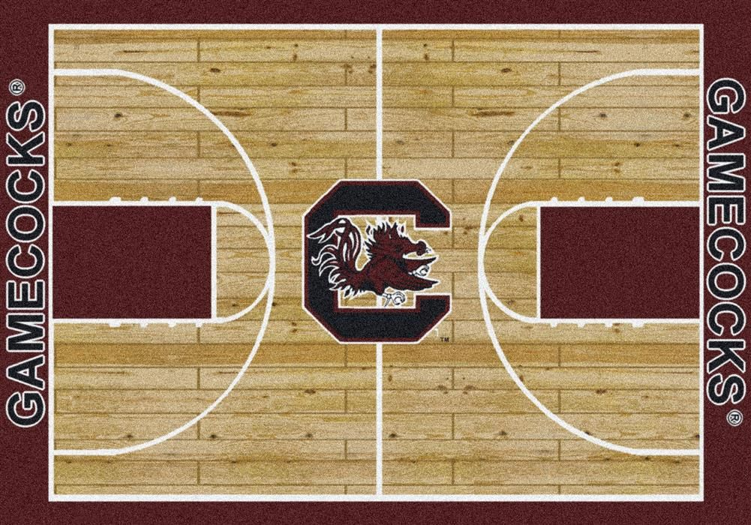
Rule 1: Court & Equipment
Playing Court (see next slide for image) shall be free from obstructions and 84’ by 50’ in High School
Division line is 2” wide--divides court into 2 halves and is to run from sideline to sideline (may have shadowline in center circle.)

Slide 3
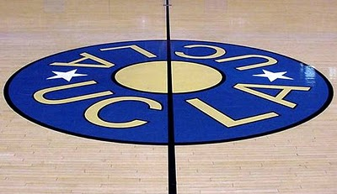
Areas of the court
Center Circle has a 6’ radius
Three-point line is 19’ 9”

Slide 4
Free throw lane
Twelve feet wide
There are 6 marked lanes spaces
Only the last three lane spaces above the block on each side of the lane can be occupied when a Free Throw is awarded.
A maximum of 4 B (defensive) players may be along the lane lines—2 B players must occupy the first two lane spaces above the block
A maximum of 2 A (offensive) players may be along the lane lines

Slide 5
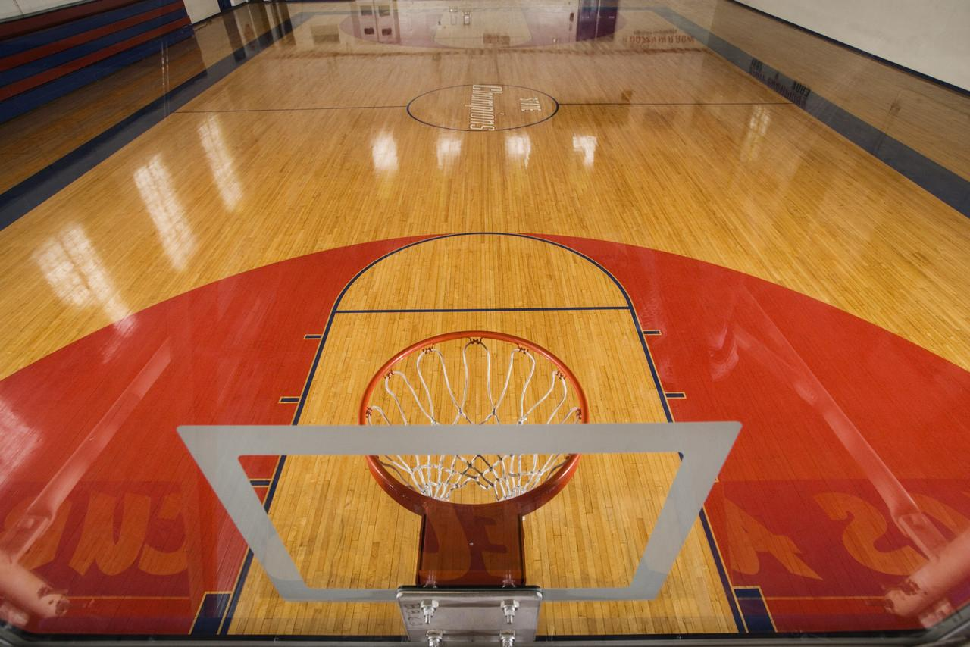
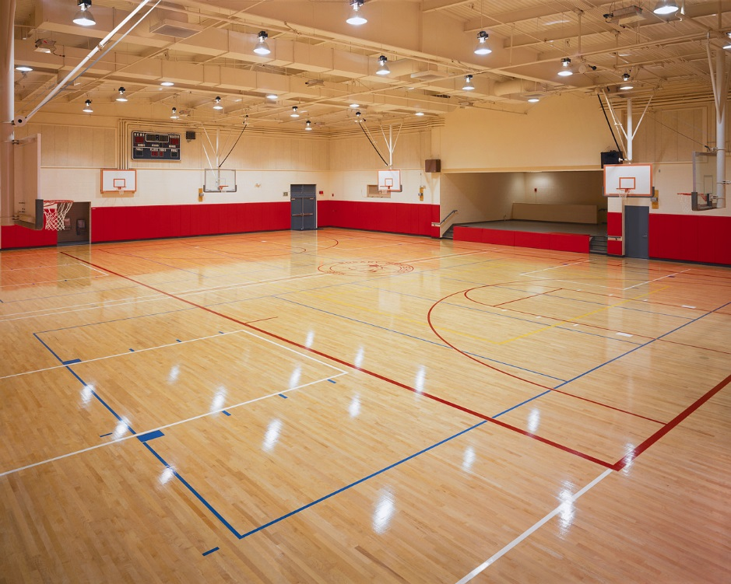
The Court

Slide 6
Backboards
Most backboards are rectangular
Must be 6’ x 4’ or 6’ x 3.5’
Must be same size/shape on both ends of court
Unless it is transparent, it shall be white. Tinted glass backboards are prohibited.
If a nontransparent white, the box is to be black or bright orange

Slide 7
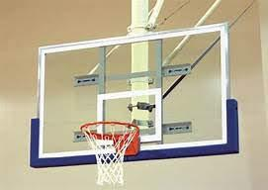
Backboards
No logos, markings allowed on the boards
Padding must cover the bottom surface and up the sides 15”

Slide 8
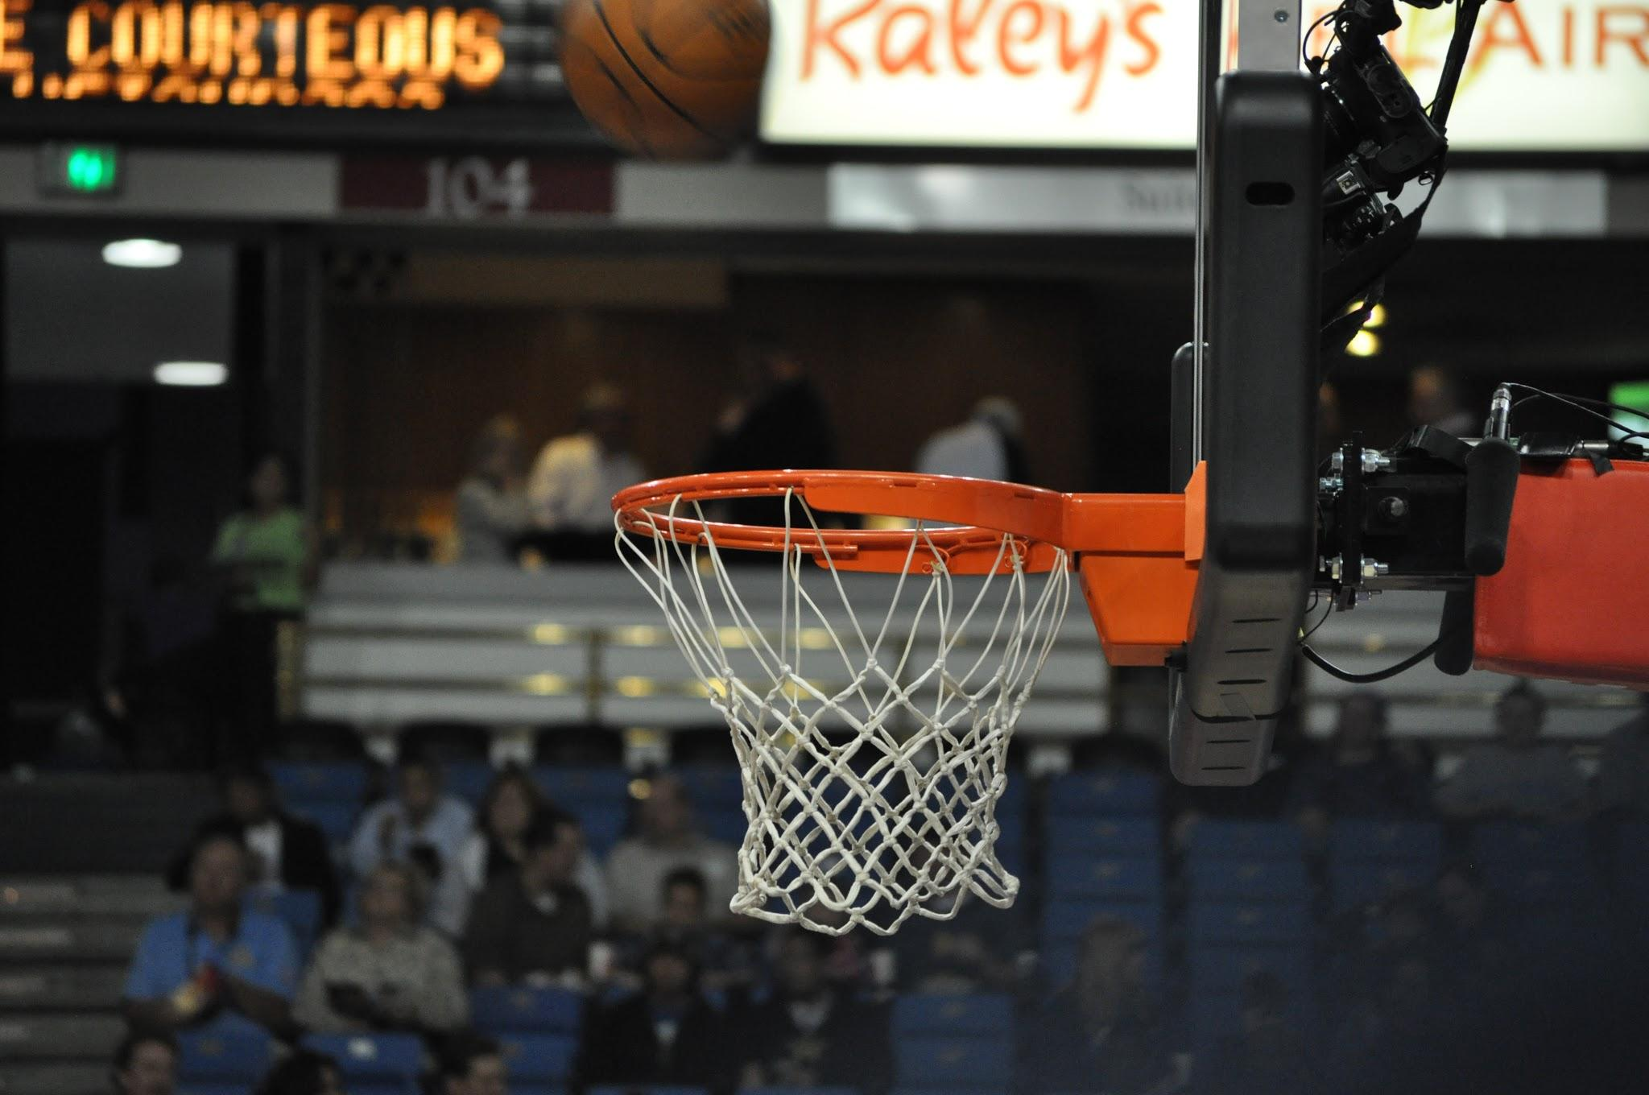
Basket
A single metal ring 18” inside diameter, bright orange in color
Shall have a #12 mesh 120-144 thread white net that is 15”-18” long
The Basket is to be attached with a ring restraining device no more than ⅝ inch in diameter.
The ring can be of the movable variety

Slide 9
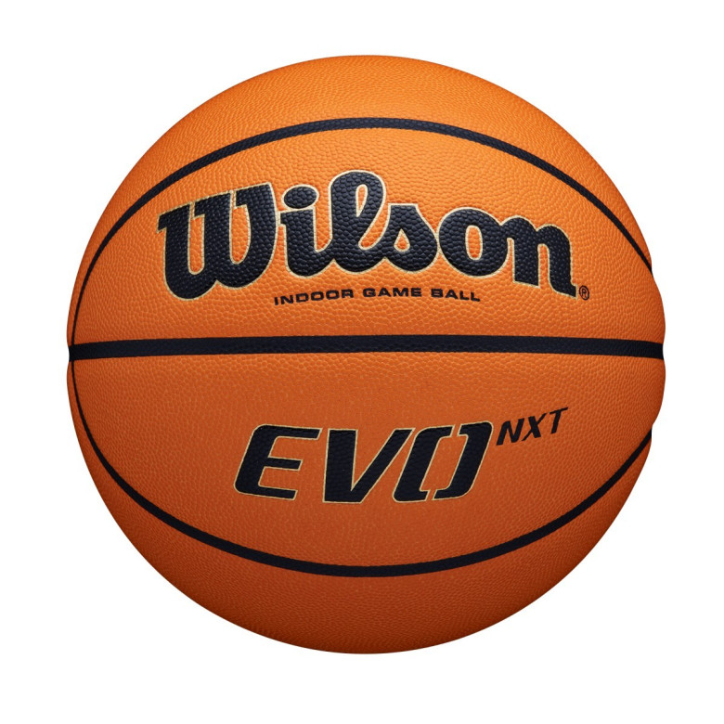
The Ball
Solid Brown or orange in color
Women—28.5” to 29” in circumference. 18-20 oz.
Men—29.5” to 30” in circumference. 20-22 oz.
Properly inflated ball will rebound 49-54 inches when dropped from 6 feet
Home team is to provide the game ball
If the home ball is not suitable as determined by the referee they may select an alternate compliant ball from the visitors.

Slide 10
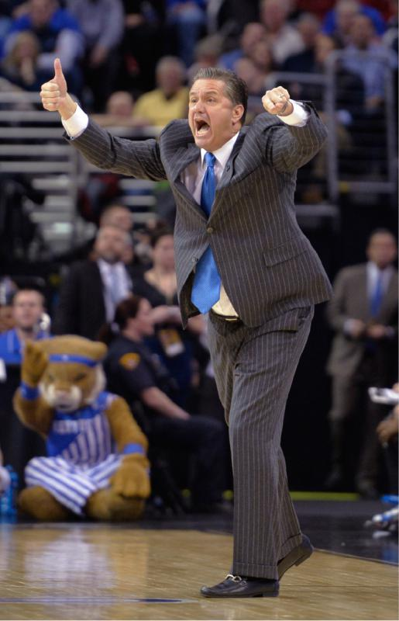
CoachING Box
Notice title does not say “Coach’s” or “Coaches” Box
Begins at the 28’ line/mark and extends towards the endline (commonly called baseline)
The box is entirely out of bounds—coach cannot legally walk, stand, coach on the court inside the boundary lines.

Slide 11
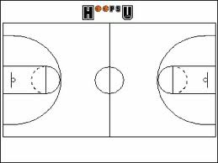
Time Out Area
Formed by an imaginary line extended from the coaching-box line to form a rectangle as shown
Extends from the bench area to the nearest free throw lane line area

Slide 12
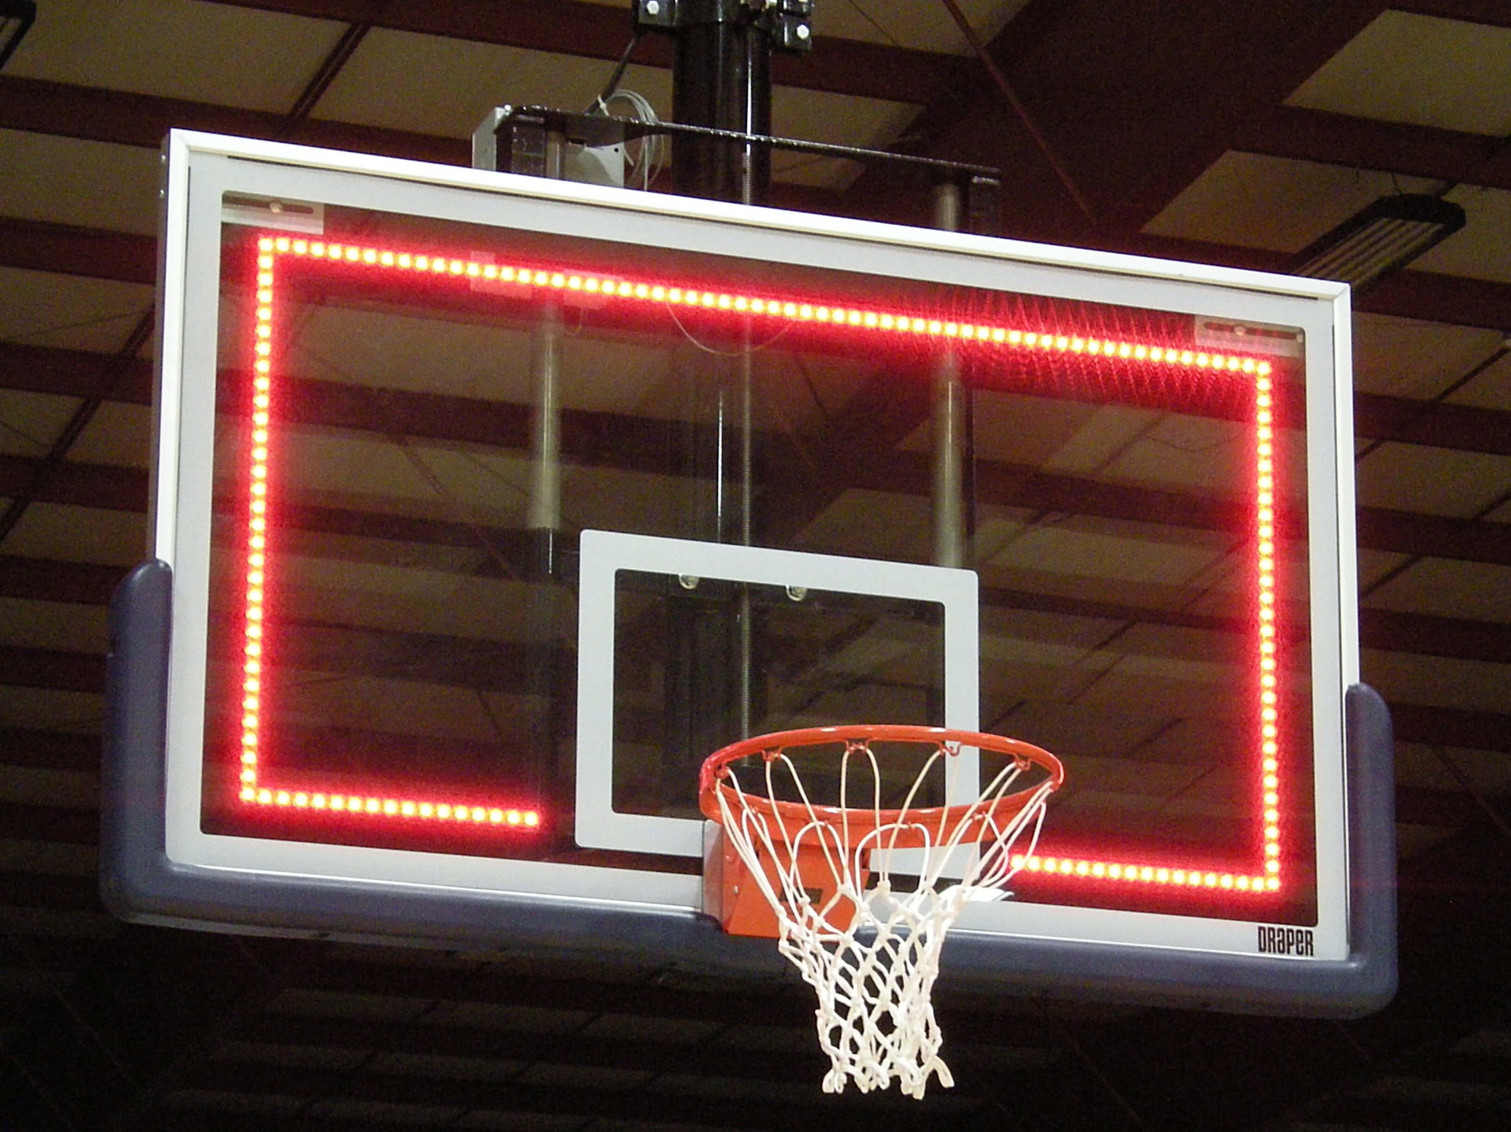
Supple-mental
Red Light on the Backboard
It is recommended, but not mandatory to have to supplement the horn in indicating the end of the period
In Facilities without a Red Light the horn shall indicate the end of periods

Slide 13
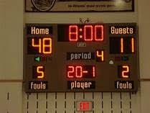
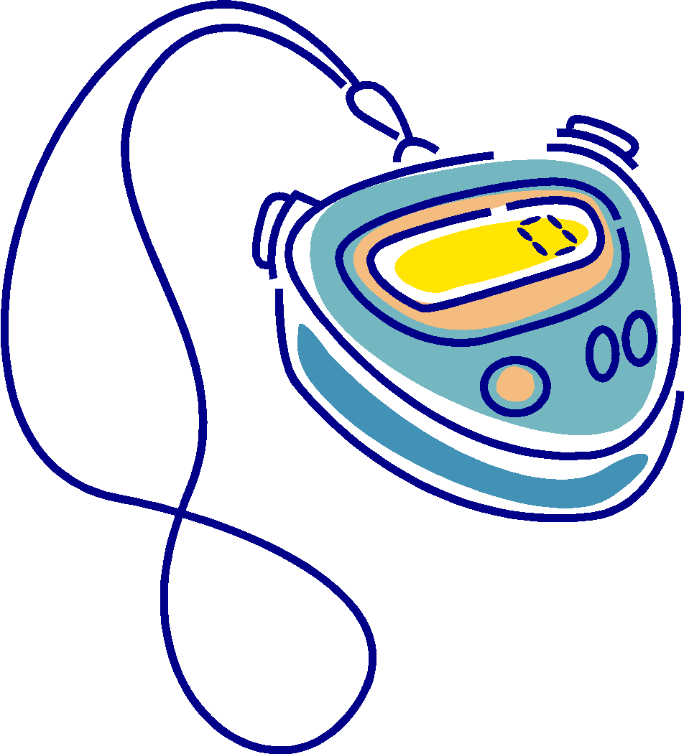
Game Clock & Scoreboard
Mandatory to have a visible clock and scoreboard
Timer shall have an alternative timing device at table in case of scoreboard malfunction

Slide 14
Possession Arrow
It must be kept at the scorer’s table (even if it’s on the scoreboard on the wall)
Needs to be visible to the officials

Slide 15
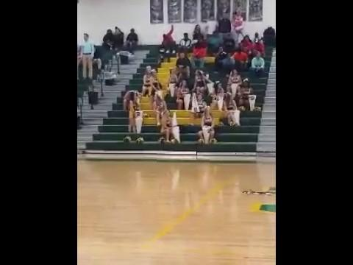
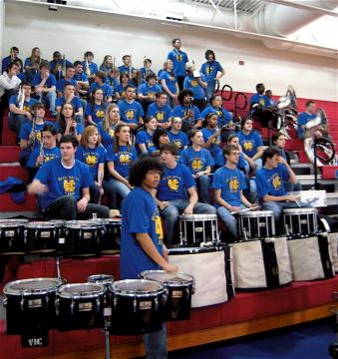
Music, Sound Effects & Artificial Noise-
makers
Only permitted during pre-game, time-outs, intermissions, and postgame
Pep Bands—Can only play before the game, halftime, and after the game
All Artificial Noisemakers are prohibited
PA Announcers—only give basic info!
Do nots:
“Threeeeeeeeeeeeeeeeeee by Jane Doe”

Slide 16
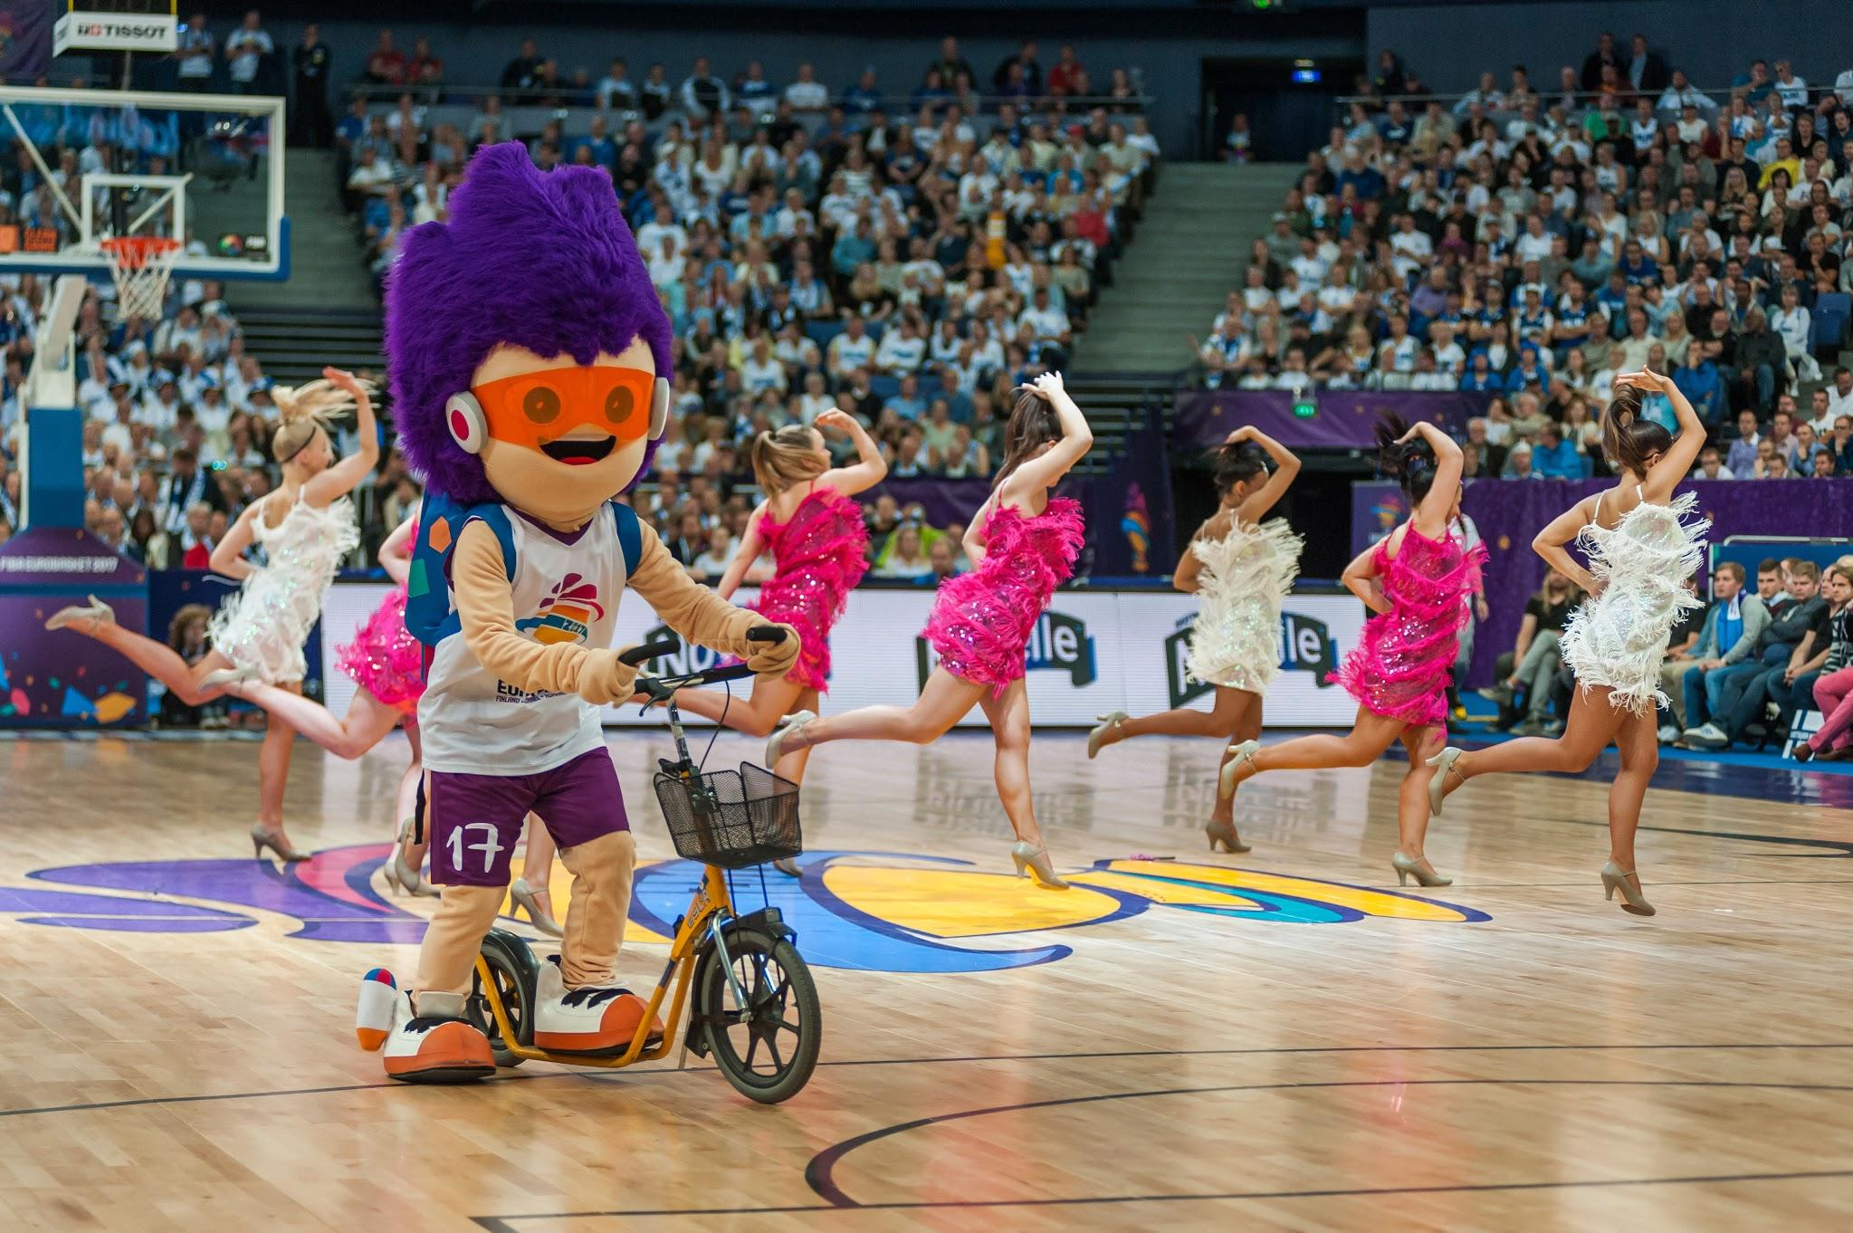
Non-Playing Personnel
Spirit Personnel (Cheerleaders) shall stay off the floor during 30-Second Timeouts
Shall be located outside the free-throw lane lines

Slide 17
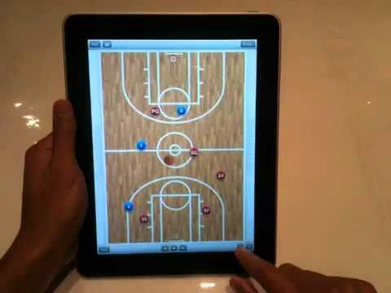
Electronic Devices
Tablets/mobile devices can be used during games for coaching purposes
Cannot be used to communicate to players on the court or to personnel in other parts of the gym
Can be used at halftime

